Slide 1

Data Mining in Bioinformatics Fundamentals of Data Science
Project Presentation
Aisha – Menna – Hosna - Yomna

Slide 2
What is Bioinformatics ?
- Understand Biological Data
- Biological data: Genes, DNA, RNA, Protein, EHRs
- DNA Language - English Human Language
DNA Alphabet English Alphabet
DNA Sentence English Sentence
A C G T
A B C D E F ..
AGGGAGAATGTTGAAACACAAGC
I Love Bioinformatics
[1]

Slide 3
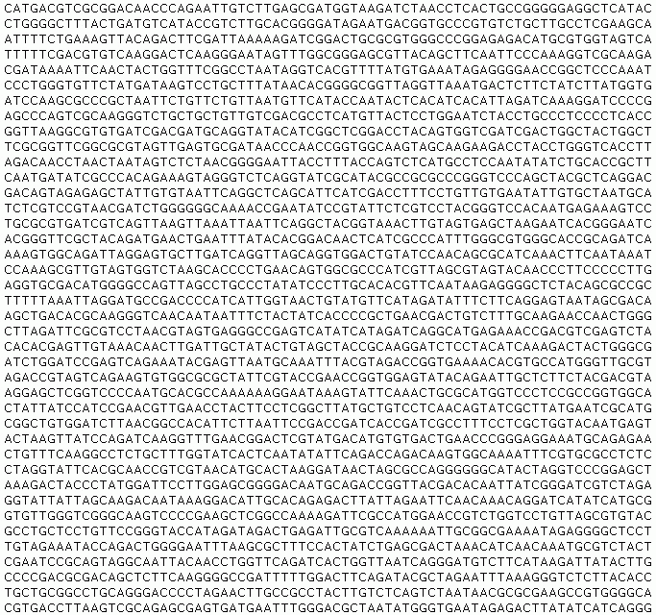
Explotion of Biological Data
Data Mining
[2]

Slide 4

Main WorkFlow
- Data Preprocessing
- Clustering
- Classification
- Deep learning

Slide 5
Pre-Processing
Data cleaning
Data transformation
Data reduction
References: [2] [3]

Slide 6
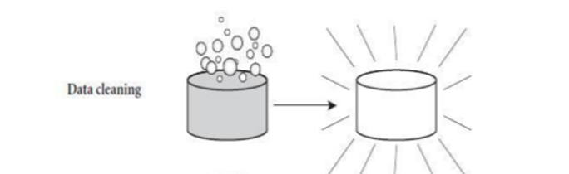
Data cleaning
Missing data
- Ignore the tuples
- Fill the missing values
Noisy data
- Binning
- Regression
- clustering
References: [2] [3]

Slide 7
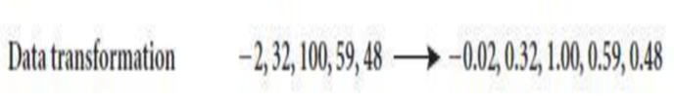
Data transformation
Normalization
Attribute selection
Generalization
References: [2] [3]

Slide 8
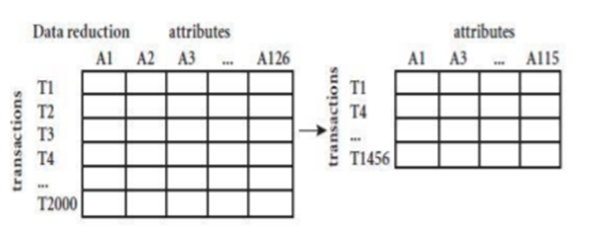
Data Reduction
Data cube aggregation
Dimensionality reduction
Numerosity reduction
References: [2] [3]

Slide 9


Imbalanced Data
Asymmetric Distribution
- Hospitals
- General Population
- Rare Diseases

Slide 10
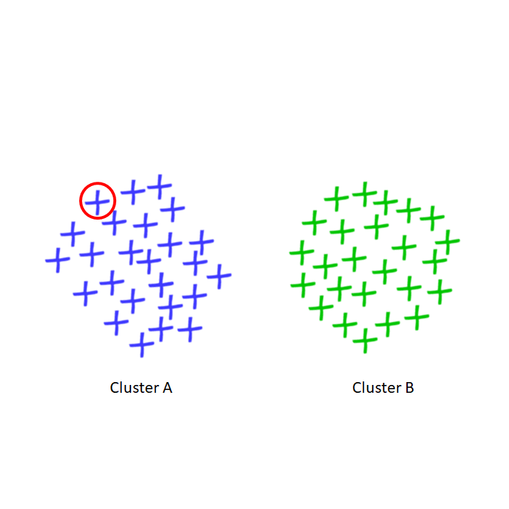
Clustering
Exploring hidden structure
- What is the function of the Red Gene ?

Slide 11
Fuzzy Clustering
One gene in Two clusters !

Slide 12
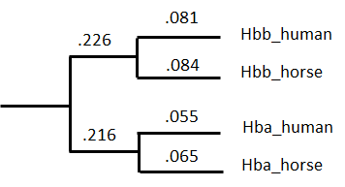
Hierarchical clustering: phylogenetic trees
- Cure
- Clinical Trials
- Covid 19 and Bats,
How did we know?

Slide 13
Classification in Bioinformatics
Applications
Ex: Identify the gene signature of a disease, Classify patients' data for medical diagnosis, Evaluation of disease severity,... etc.

Slide 14
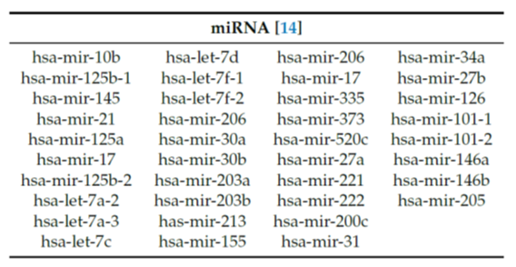
Breast Cancer Detection
Dataset Features: MicroRNAs as biomarkers.
Fig: Clinically Verified MiRNAs

Slide 15
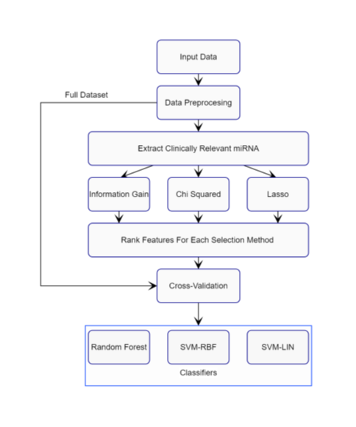
Flow of the Experiment
Fig: Schematics for Cancer Detection with Machine Learning

Slide 16
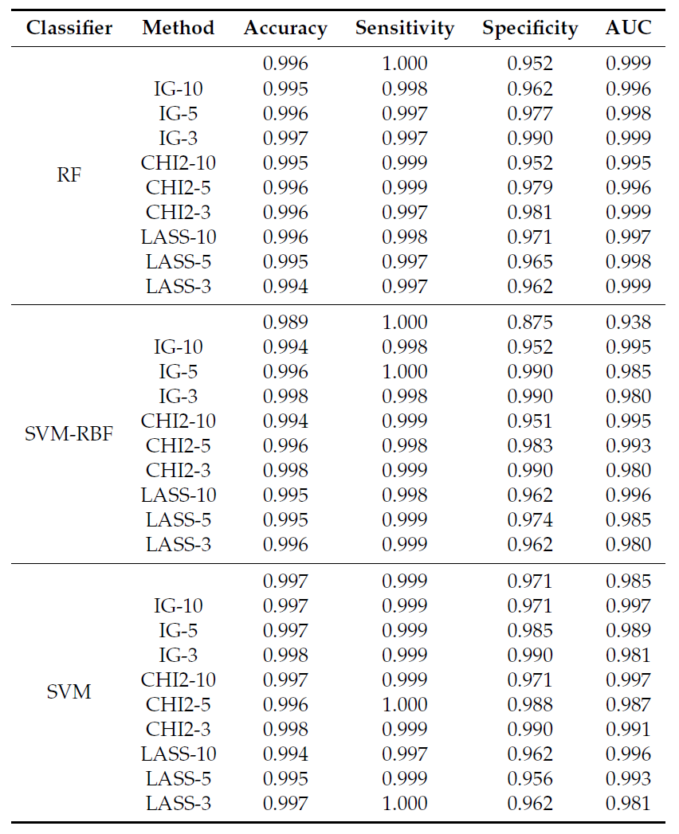
Evaluation
Fig: Performance Metrics of Classifiers with Different Feature Selection Methods Over MiRNAs Subsets(3, 5, 10)

Slide 17
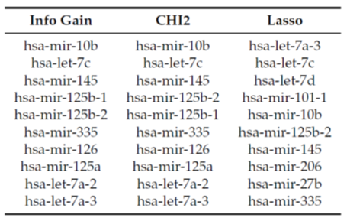
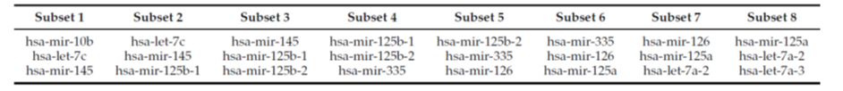
Selecting Fewer Features for Classification
Fig: Top Ranked Features Under Different Feature Selection Techniques
Fig: Subsets of Ranked miRNAs

Slide 18
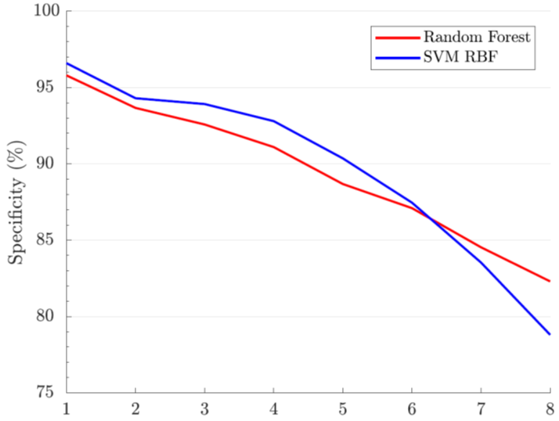
Performance Evaluation Over Different Subsets
Fig: Specificity Across Different Clinical miRNA Subsets

Slide 19
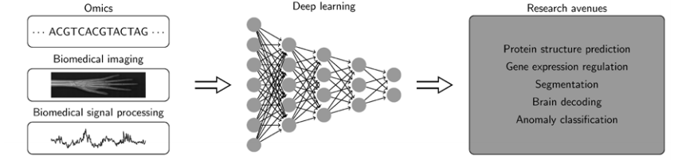
Deep learning in bioinformatics
Increasing computational capacity and the improved algorithms.
Massive amount of data.
Automatic feature extraction.

Slide 20
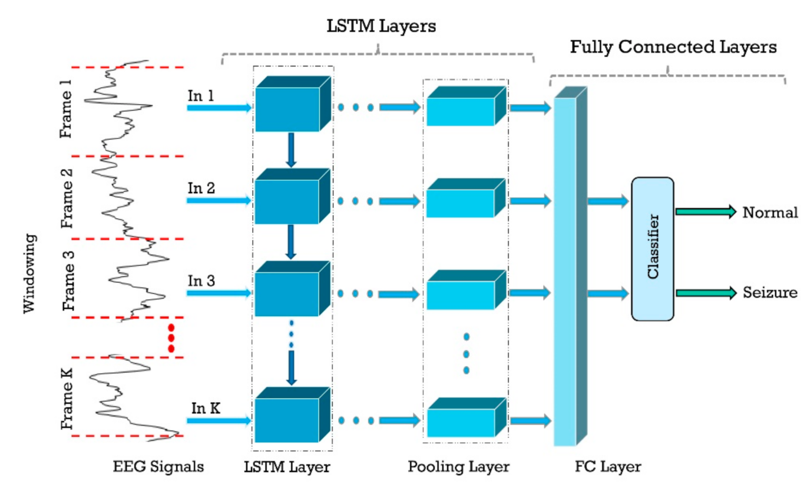
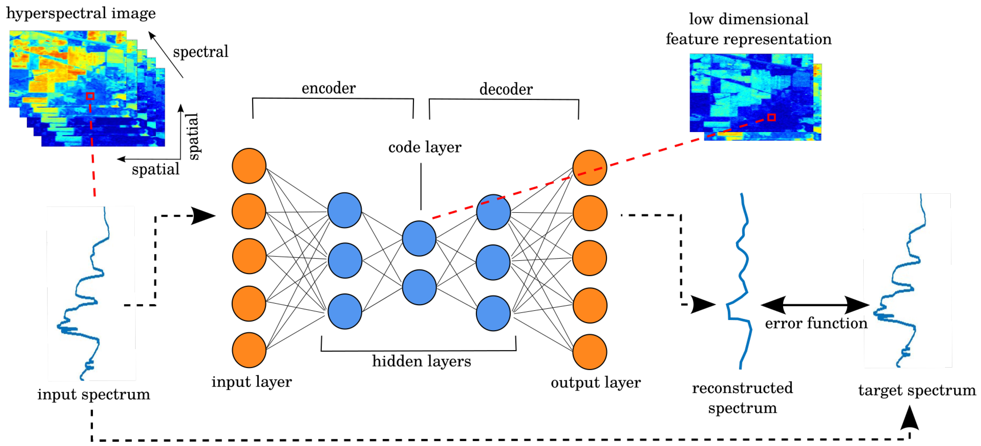
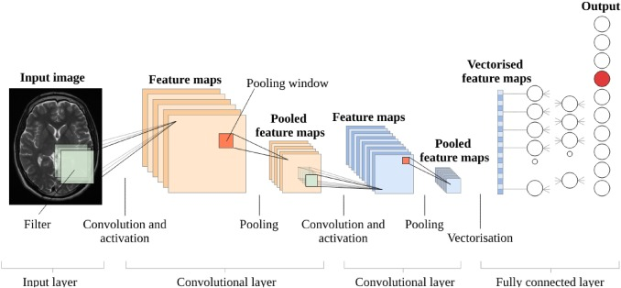
Deep learning Architectures & Applications
Convolutional neural networks.
Recurrent neural networks.
Autoencoder.

Slide 21
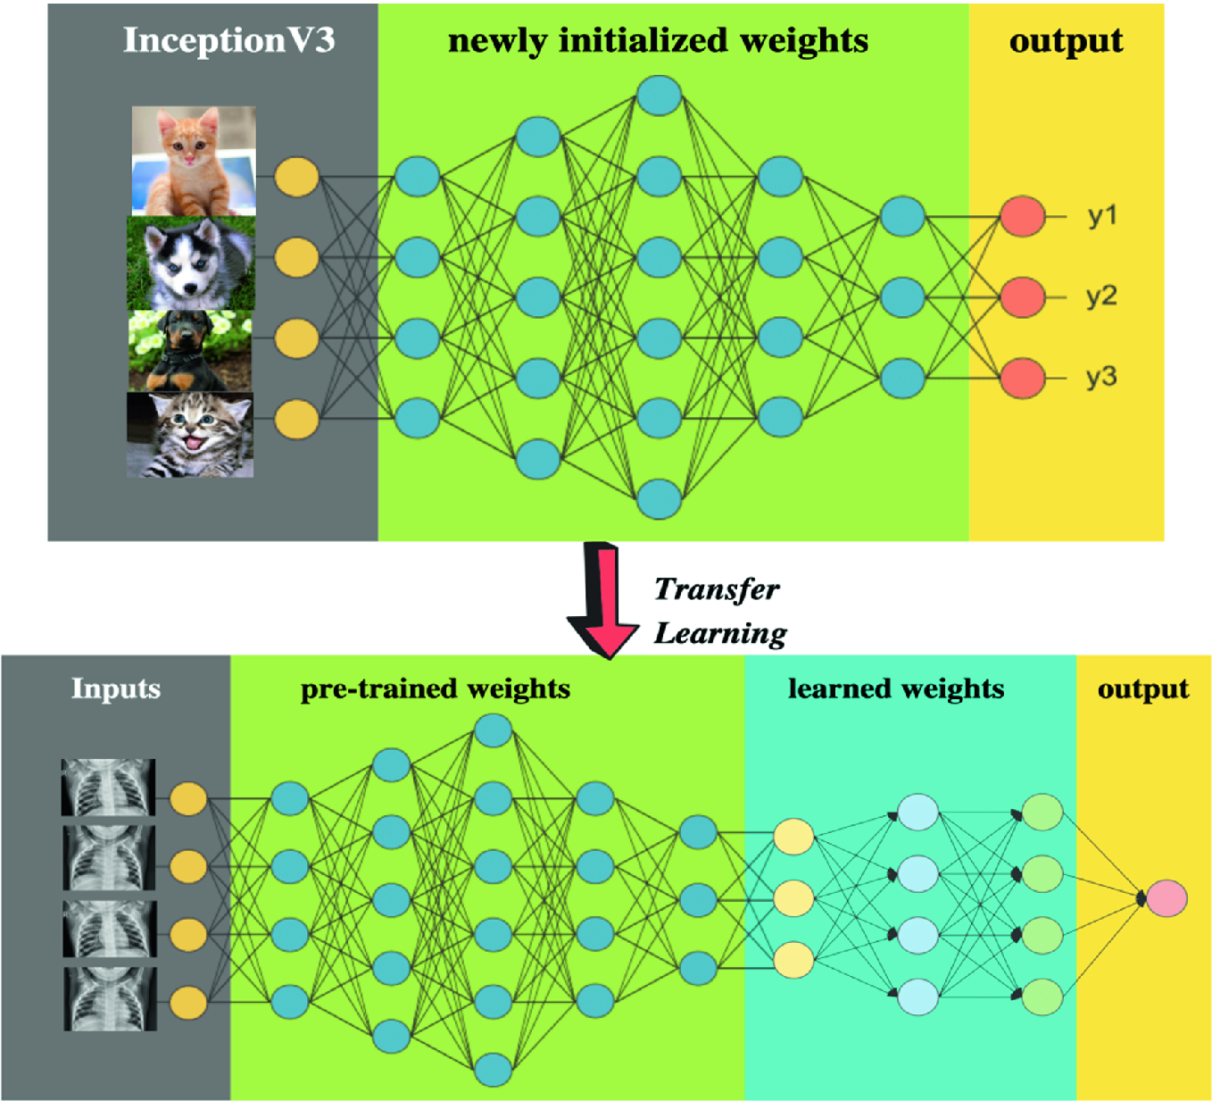
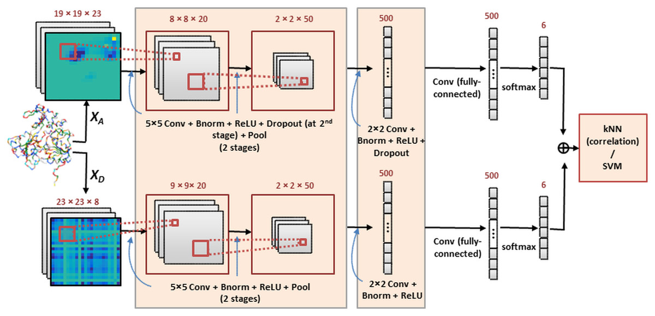
Deep learning Architectures & Applications
Ensemble deep learning in bioinformatics.
Transfer Learning in Deep Learning.

Slide 22
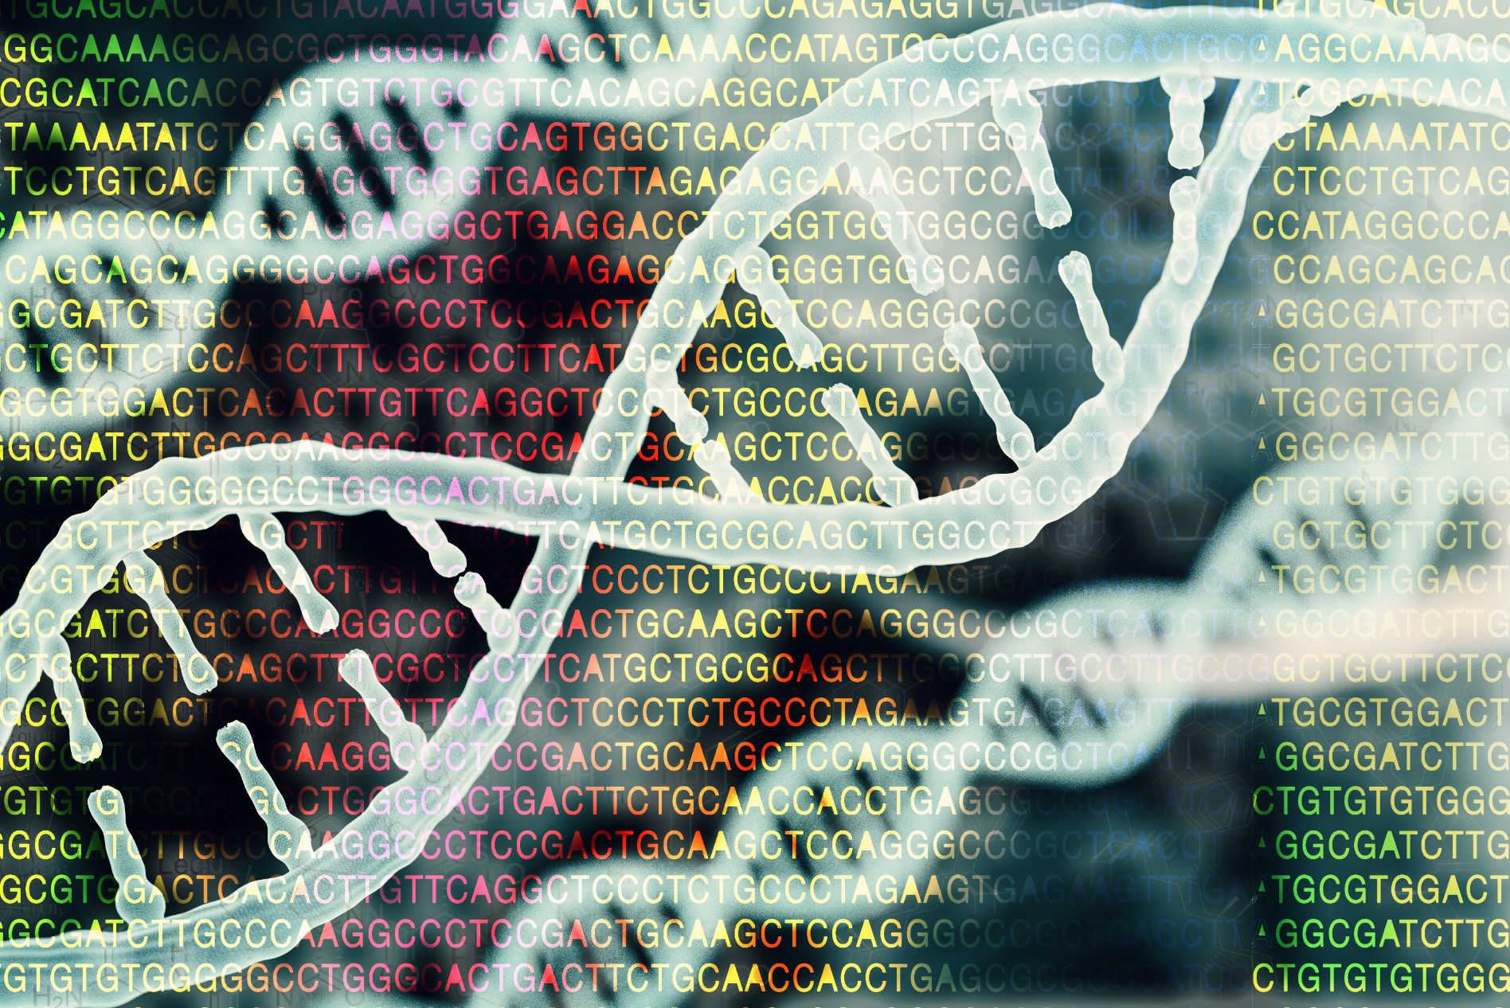
Challenges
- Heterogeneous data
- No standard schema
- Imbalanced data
- Interpretability of models
- Computational challenges
CURSE of Dimentionality

Slide 23
References
Rehman O, Zhuang H, Muhamed Ali A, Ibrahim A, Li Z. Validation of miRNAs as Breast Cancer Biomarkers with a Machine Learning Approach. Cancers. 2019; 11(3):431. https://doi.org/10.3390/cancers11030431
A Survey on Data Preprocessing Techniques for Bioinformatics and Web Usage Mining 1A. Sivakumar and 2R.Gunasundari 1Department of Computer Science, Karpagam University, Coimbatore. sivamgp@gmail.com 2Department of Information Technology, Karpagam University, Coimbatore.
Jamshed, H., Ali Khan, M. S., Khurram, M., Inayatullah, S. y Athar, S. (2019). Data Preprocessing: A preliminary step for web data mining, Pakistan.
Min, S., Lee, B., & Yoon, S. (2016). Deep learning in bioinformatics. Briefings in Bioinformatics, bbw068. https://doi.org/10.1093/bib/bbw068
Tang, B., Pan, Z., Yin, K., & Khateeb, A. (2019). Recent Advances of Deep Learning in Bioinformatics and Computational Biology. Frontiers in Genetics, 10. https://doi.org/10.3389/fgene.2019.00214

